Slide 1
NETWORKS,PROTOCOLS AND SECURITY (NPS)
COURSE CODE: 22EC2210R
CO1_ PHYSICAL LAYER
SESSION NO: 5
EXAMPLE OF NETWORKS
GUIDED AND UNGUIDED TRANSMISSION MEDIA

Slide 2
EXAMPLE OF NETWORKS
1)The Internet :
The Internet is not really a network at all, but a vast collection of different networks that use certain common protocols and provide certain common services.
2)Mobile Networks:
First-generation mobile phone systems transmitted voice calls as continuously varying (analog) signals rather than sequences of (digital) bits. AMPS (Advanced Mobile Phone System), which was deployed in the United States in 1982, was a widely used firstgeneration system.
3)Wireless Networks (WiFi):
LAN standards had numbers like 802.1, 802.2, and 802.3, up to 802.10, so the wireless LAN standard was dubbed 802.11

Slide 3
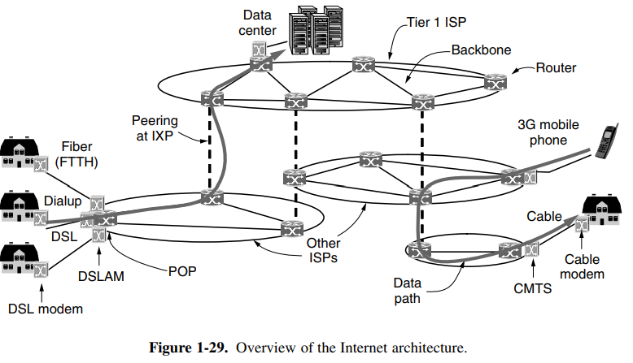
Architecture of the Internet

Slide 4
To join the Internet, the computer is connected to an Internet Service Provider, or simply ISP, from who the user purchases Internet access or connectivity. This lets the computer exchange packets with all of the other accessible hosts on the Internet. The user might send packets to surf the Web or for any of a thousand other uses, it does not matter. There are many kinds of Internet access, and they are usually distinguished by how much bandwidth they provide and how much they cost, but the most important attribute is connectivity.
A common way to connect to an ISP is to use the phone line to your house, in which case your phone company is your ISP. DSL, short for Digital Subscriber Line, reuses the telephone line that connects to your house for digital data transmission. The computer is connected to a device called a DSL modem that converts between digital packets and analog signals that can pass unhindered over the telephone line. At the other end, a device called a DSLAM (Digital Subscriber Line Access Multiplexer) converts between signals and packets.

Slide 5
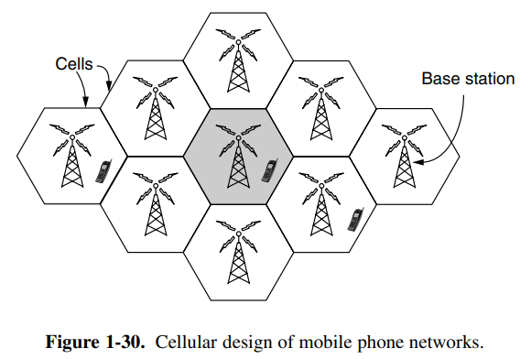
Mobile networks

Slide 6
Cellular network design shown in Fig. 1-30 that is now used for mobile phone networks. To manage the radio interference between users, the coverage area is divided into cells. Within a cell, users are assigned channels that do not interfere with each other and do not cause too much interference for adjacent cells. This allows for good reuse of the spectrum, or frequency reuse, in the neighboring cells, which increases the capacity of the network.
Modern 3G systems allow each cell to use all frequencies, but in a way that results in a tolerable level of interference to the neighboring cells.

Slide 7
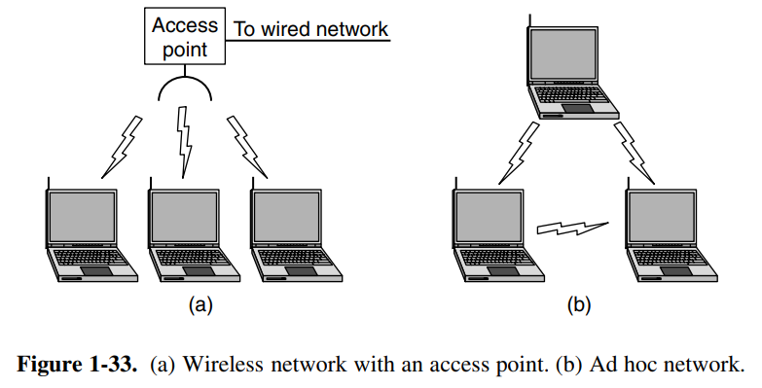
WIRELESS LANS: 802.11

Slide 8
All devices are allowed to use this spectrum provided that they limit their transmit power to let different devices coexist. Of course, this means that 802.11 radios may find themselves competing with cordless phones, garage door openers, and microwave ovens. 802.11 networks are made up of clients, such as laptops and mobile phones, and infrastructure called APs (access points) that is installed in buildings. Access points are sometimes called base stations.
The access points connect to the wired network, and all communication between clients goes through an access point. It is also possible for clients that are in radio range to talk directly, such as two computers in an office without an access point. This arrangement is called an ad hoc network. It is used much less often than the access point mode. Both modes are shown in Fig. 1-33.

Slide 9
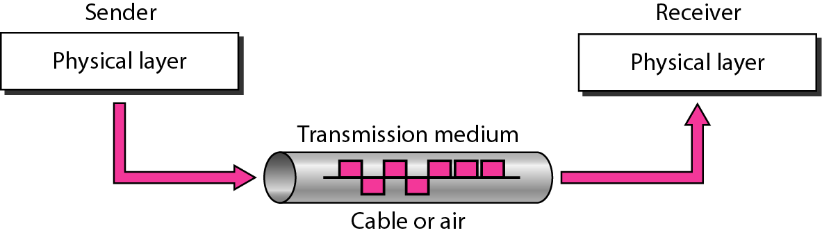
TRANSMISSION MEDIA
Transmission media are actually located below the physical layer and are directly controlled by the physical layer. You could say that transmission media belong to layer zero.
Transmission media is a communication channel that carries the information from the sender to the receiver.
The main functionality of the transmission media is to carry the information in the form of bits (Either as Electrical signals or Light pulses).
Figure shows the position of transmission media in relation to the physical layer.

Slide 10
FACTORS FOR DESIGNING THE TRANSMISSION MEDIA
Bandwidth: All the factors are remaining constant, the greater the bandwidth of a medium, the higher the data transmission rate of a signal.
Transmission impairment: When the received signal is not identical to the transmitted one due to the transmission impairment. The quality of the signals will get destroyed due to transmission impairment.
Interference: An interference is defined as the process of disrupting a signal when it travels over a communication medium on the addition of some unwanted signal.

Slide 11
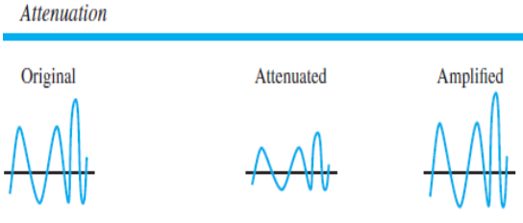
CAUSES OF TRANSMISSION IMPAIRMENT:
Attenuation: Attenuation: Attenuation means the loss of energy, i.e., the strength of the signal decreases with increasing the distance which causes the loss of energy

Slide 12
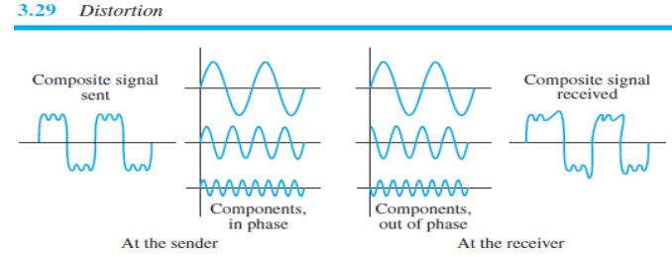
Distortion: Distortion occurs when there is a change in the shape of the signal.

Slide 13
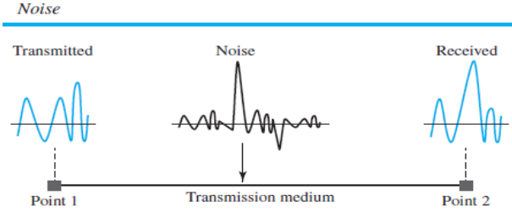
Noise: When data is travelled over a transmission medium, some unwanted signal is added to it which creates the noise.

Slide 14
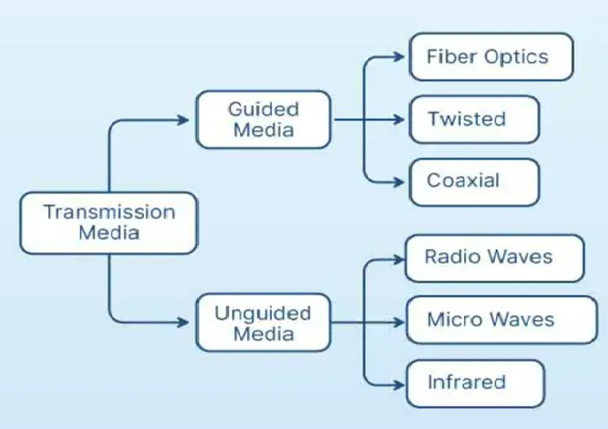
CLASSIFICATION OF TRANSMISSION MEDIA

Slide 15
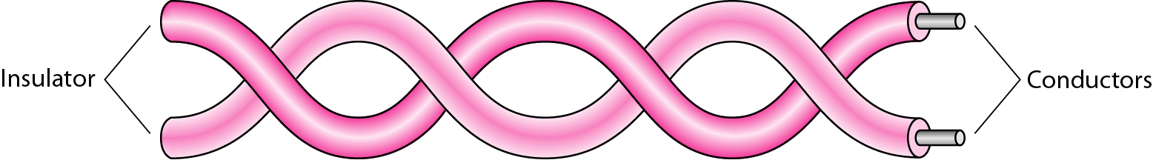
Guided Media(Wired or Bounded)
Twisted Pair Cable
Twisted pair is a physical media made up of a pair of cables twisted with each other.
A twisted pair cable is cheap as compared to other transmission media.
Installation of the twisted pair cable is easy, and it is a lightweight cable.
The frequency range for twisted pair cable is from 0 to 3.5KHz.
A twisted pair consists of two insulated copper wires arranged in a regular spiral pattern.

Slide 16
Advantages of Twisted pair cable:
Installation is easy
High speed
Can carry both analog and digital data
Cheaper than other transmission media
If some part of twisted pair cable is damaged, it does not affect the entire network
Disadvantages of Twisted pair cable:
Poor security
Not durable, easy to break
Attenuation is high
Supports only lower bandwidth.
Applications of Twisted Pair Cables:
In telephone lines.
Local area networks such as small office and data centres.

Slide 17
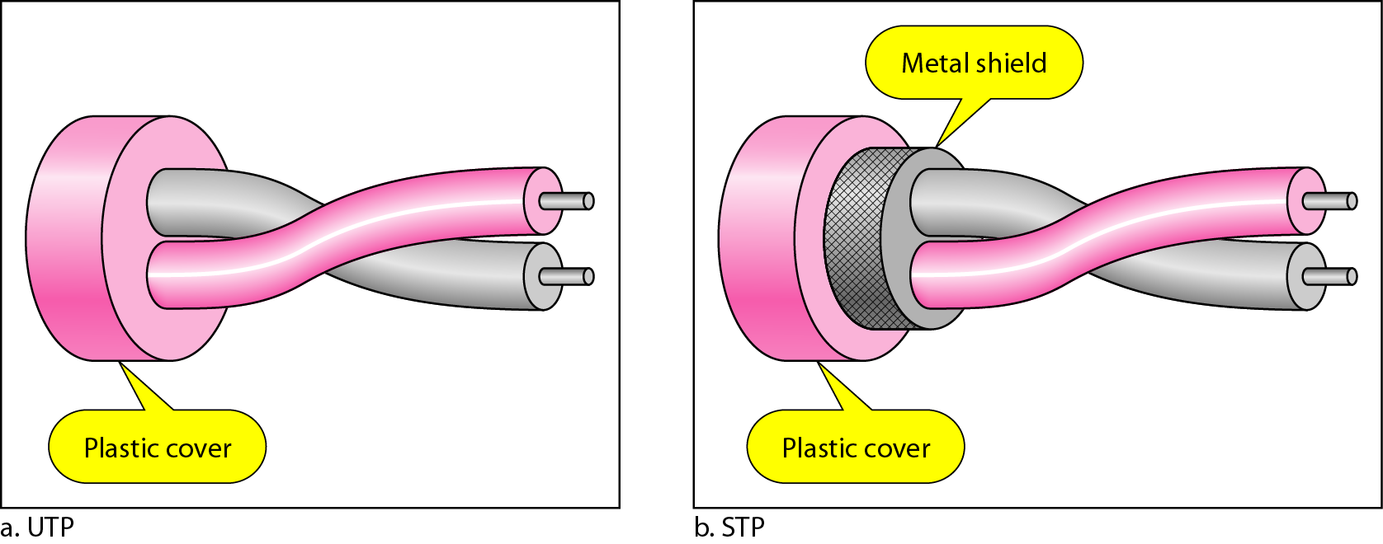
Types of Twisted Pair Cable
Unshielded Twisted-Pair Cable:
The most common twisted-pair cable used in communications is referred to as unshielded twisted-pair (UTP). Unshielded Twisted Pair An unshielded twisted pair is widely used in telecommunication.
Following are the categories of the unshielded twisted pair cable: o Category 1: Supports low-speed data.
Category 2: It can support upto 4Mbps.
Category 3: It can support upto 16Mbps.
Category 4: It can support upto 20Mbps.
Category 5: It can support upto 200Mbps.
Shielded Twisted-Pair Cable:
IBM has also produced a version of twisted-pair cable for its use called shielded twisted-pair (STP).
Shielded Twisted Pair A shielded twisted pair is a cable that contains the mesh surrounding the wire that allows the higher transmission rate.

Slide 18
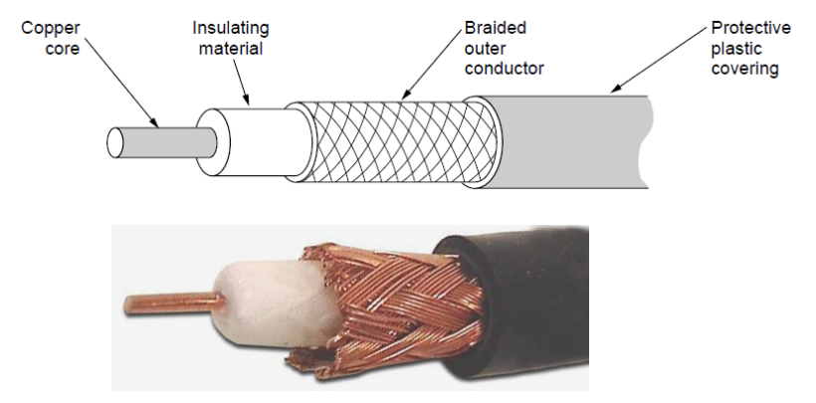
Coaxial Cable
Coaxial cable has a centre conductor enclosed in a insulating cover, which in turn is enclosed in a metal foil shield.
The whole cable is covered in a plastic cover. The metal foil shield protects against the noise, it consists two conductors parallel to each other.
Advantages of Coaxial cable:
High speed data transmission.
Better noise reduction.
High bandwidth.
Disadvantages of Coaxial cable:
More expensive than twisted pair cable.
Types of Coaxial cable :
Baseband transmission: It is defined as the process of transmitting a single signal at high speed.
Broadband transmission: It is defined as the process of transmitting multiple signals simultaneously.

Slide 19
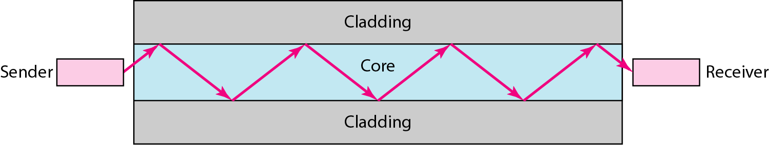
Fiber-Optic Cable (Optical-fiber)
Fiber-Optic Cable is also known as . It is made of glass and the transmission of data is based on the concept of reflection of light through glass.
Fiber-Optic Cable Propagation Modes:
Multimode: Multiple light sources moves through different paths inside coaxial cable. Multiple data transmission simultaneously.
Singlemode: Light moves in a single path close to horizontal of the cable.
Advantages of Fiber Optic Cable:
High bandwidth
High speed
Longer range
Reliable

Slide 20
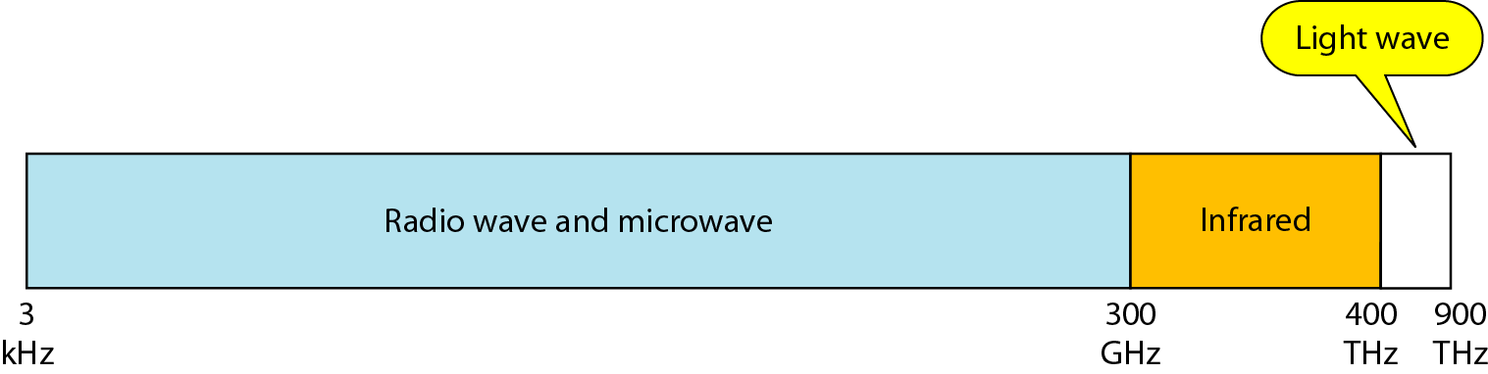
UNGUIDED MEDIA
An unguided transmission transmits the electromagnetic waves without using any physical medium. Therefore it is also known as wireless transmission.
In unguided media, air is the media through which the electromagnetic energy can flow easily.
Unguided transmission is classified into three categories : Radio Waves, Microwaves , Infrared
Electromagnetic Spectrum For Wireless Communication

Slide 21
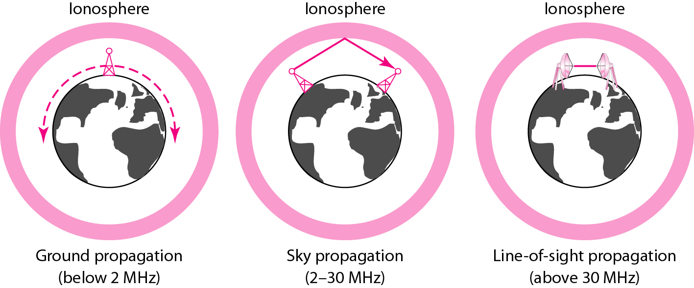
Propagation Methods

Slide 22
RADIO WAVES
Radio waves are the electromagnetic waves that are transmitted in all the directions of free space.
Radio waves are omnidirectional, i.e., the signals are propagated in all the directions.
The range in frequencies of radio waves is from 3Khz to 1Khz. o In the case of radio waves, the sending and receiving antenna are not aligned, i.e., the wave sent by the sending antenna can be received by any receiving antenna.
Radio signals penetrate buildings well and propagate for long distances with path loss
Advantages:
Radio transmission is mainly used for wide area networks and mobile cellular phones.
Radio waves cover a large area, and they can penetrate the walls.
Radio transmission provides a higher transmission rate.
Disadvantages :
Not possible to isolate the communication inside the building.

Slide 23
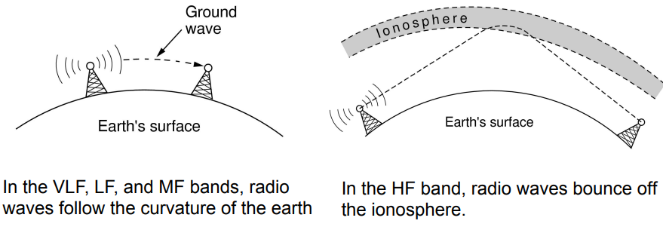
Applications:
A Radio wave is useful for multicasting when there is one sender and many receivers.
An FM radio, television, cordless phones are examples of a radio wave.

Slide 24
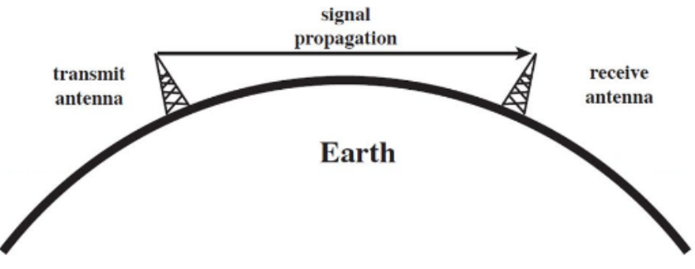
MICROWAVES
Microwaves are of two types
– Terrestrial microwave
-- Satellite microwave
Terrestrial Microwave:
Terrestrial Microwave transmission is a technology that transmits the focused beam of a radio signal from one ground-based microwave transmission antenna to another.
Microwaves are the electromagnetic waves having the frequency in the range from 1GHz to 1000 GHz. Microwaves are unidirectional as the sending and receiving antenna is to be aligned, i.e., the waves sent by the sending antenna are narrowly focused.
In this case, antennas are mounted on the towers to send a beam to another antenna which is km away.
It works on the line of sight transmission, i.e., the antennas mounted on the towers are at the direct sight of each other.

Slide 25
Characteristics of Microwave :
Frequency range: The frequency range of terrestrial microwave is from 4-6 GHz to 21-23 GHz.
Bandwidth: It supports the bandwidth from 1 to 10 Mbps.
Attenuation: Attenuation means loss of signal. It is affected by environmental conditions and antenna size.
Advantages
Microwave transmission is cheaper than using cables.
It is free from land acquisition as it does not require any land for the installation of cables.
It provides an easy communication in terrains as the installation of cable in terrain is quite a difficult task. o Communication over oceans can be achieved by using microwave transmission.
Disadvantages
Eavesdropping.
Susceptible to weather condition
Bandwidth limited

Slide 26
Satellite Microwave
A satellite is a physical object that revolves around the earth at a known height.
It is more reliable nowadays as it offers more flexibility than cable and fibre optic systems.
We can communicate with any point on the globe by using satellite communication.
The satellite accepts the signal that is transmitted from the earth station, and it amplifies the signal.
The amplified signal is retransmitted to another earth station.
Advantages:
The coverage area of a satellite microwave is more than the terrestrial microwave.
It is used in weather forecasting, radio/TV signal broadcasting, mobile and wireless communication etc.

Slide 27
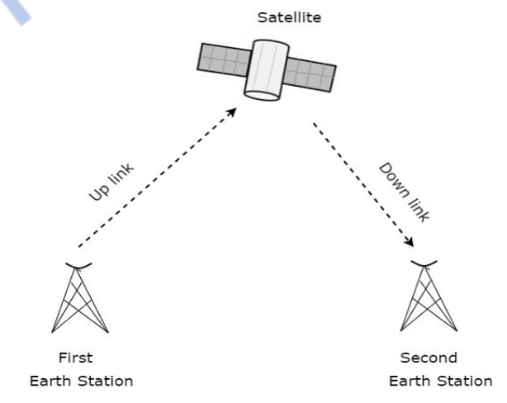
Disadvantages:
Satellite designing and development requires more time and higher cost.
Satellite needs to be monitored and controlled on regular periods so that it remains in orbit.
The life of the satellite is about 12-15 years.

Slide 28
INFRARED WAVES
An infrared transmission is a wireless technology used for communication over short ranges.
The frequency of the infrared in the range from 300 GHz to 400 THz.
It is used for short-range communication such as data transfer between two cell phones, TV remote operation, data transfer between a computer and cell phone and devices that resides in the same closed area.
Characteristics of Infrared:
It supports high bandwidth, and hence the data rate will be very high.
Infrared waves cannot penetrate the walls. Therefore, the infrared communication in one room cannot be interrupted by the nearby rooms.
An infrared communication provides better security with minimum interference.
Infrared communication is unreliable outside the building because the sun rays will interfere with the infrared waves.

